Slide 1

SoECE
Operating system and
Embedded system Design
Students Details:
Sl. No | Name | USN
1. | Murari | 01FE20BEC084
2. | Anand Doddamani | 01FE20BEC102
3. | Nitish D Kulkarni | 01FE20BEC111
4. | D S Sanjaya | 01FE20BEC115
Under the Guidance of:
Prof. Rohini Hongal

Slide 2
SoECE
Contents:
Introduction
Problem Statement
What is Semaphore , SWI and Events?
4) How it works?

Slide 3
SoECE
Problem statement:-
(Using Semaphore , SWI and Events)
Write a RTOS code to implement the elevator on occurrence of external interrupt Eint0 & Eint1 using Event Flags.

Slide 4
SoECE
SWI
SWI is software interrupt which often occurs when an application software terminates or when it requests the operating system for some service
In this project we have used two user defined software interrupts (SWI8 & SWI9)
SWI8 – Eint0 Initialization
SWI9 – Eint1 Initialization

Slide 5
SoECE
Events
An event is an action or occurrence that can be identified by a program and has significance for system hardware or software.
In our current project, Job1 waits for an event flag which is set by Eint0 and Eint1 using the API isr_evt_set( ) .
When the event is set only then the statements of the job1 will be executed and if the event flag isn't set then it will continue to wait.

Slide 6
SoECE
Semaphore
A semaphore is a variable used to control access to a common, shared resource that needs to be accessed by multiple jobs or processes.
Types of Semaphore
Binary Semaphore
Counting Semaphore
Mutex
We have used binary semaphore for the implementation of this project.

Slide 7
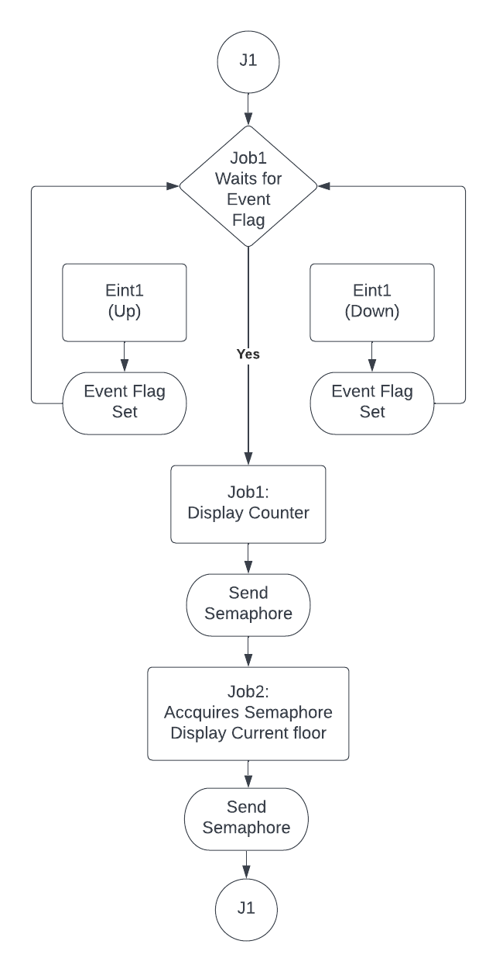
SoECE
Working

Slide 8
SoECE
Thank You

